Slide 1
FILE MANAGEMENT

Slide 2
What is File Management in Operating System?
Introduction
File management is one of the basic but essential features provided by the operating system.
File management in operating system is nothing but software that manages or handles the files ( video, audio, docs, pdf, text, etc.) present in computer software.
The operating system’s file system can manage individuals and groups of files present in the computer system.
The operating system’s file system talks to us about the modification time of creation, owner, location, and state of a file present on the computer system.

Slide 3
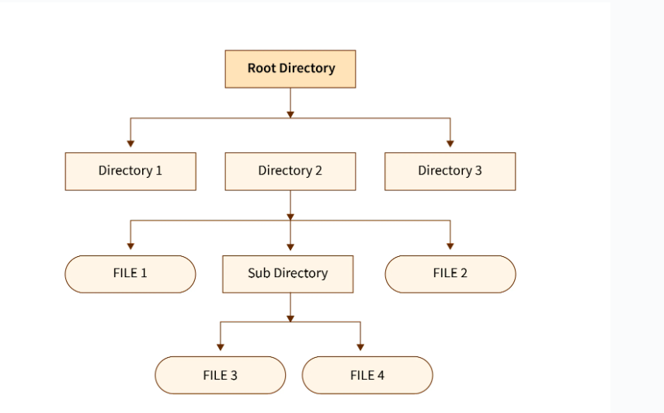

Slide 4
File management in Operating Systems is a fundamental and crucial component.
The operating system manages computer system files. Operating systems control all files with various extensions.
File management in operating system is formally defined as manipulating files in a computer system, which includes creating, modifying, and deleting files. Therefore, file management is one of the simple but crucial features offered by the operating system. The operating system’s file management function entails software that handles or maintains files (binary, text, PDF, docs, audio, video, etc.) included in computer software.
The operating system’s file system can manage single and group files in a computer system.
The operating system’s file management manages all of the files on the computer system with different extensions(such as .exe, .pdf, .txt, .docx, etc.).

Slide 5
The features of File Management in an Operating System are
Providing security to application software and system.
Memory management
Disk management.
I/O operations.
File management, etc

Slide 6
File management is the operating system, or to make the operating system understand a file, the file must be in a structure or format or predefined structure. There are three types of file structures present in the operating systems:
Text file: The text file is a non-executable file containing a sequence of symbols, numbers, and letters organized in the form of lines.
Source file: A source file is an executable file that contains a series of processes and functions. In simpler terms, we can say that a source file is a file that contains the instructions of a program.
Object file: An object file is a file that contains object code in the form of assembling language code or machine language code. In simpler terms, we can say that an object file contains program instructions in the form of a series of organized bytes in the form of blocks.

Slide 7
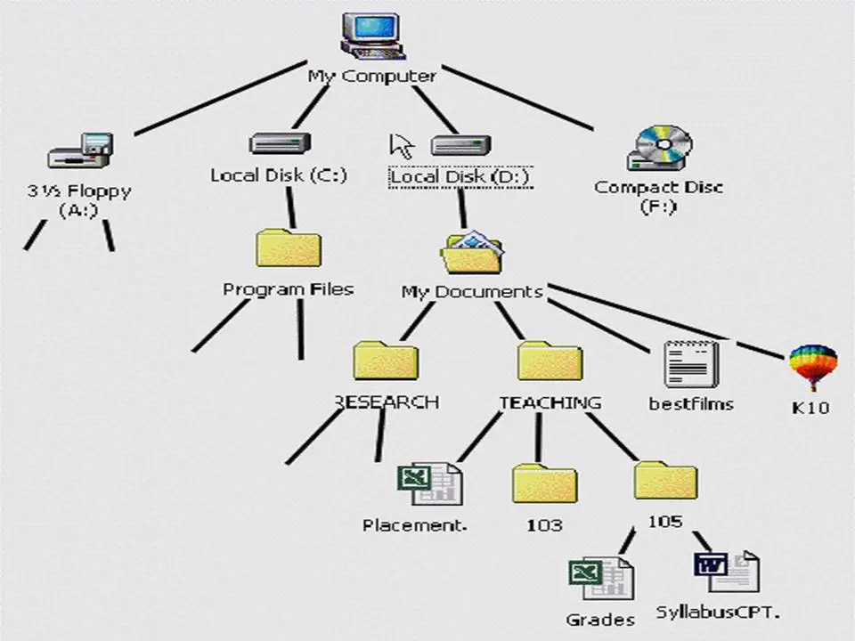
What are the Functions of a File Management System in Operating System ?
Allows users to modify, create, and delete files on the computer system.
Operates on and manages a file’s permissions for different users and groups.
Enables improved visualization by structuring the files like a tree.
Interface for I/O operations is provided.
Protects data from hackers and unwanted access.

